Slide 1
Bidirectional Bandwidth Coordination under Half-Duplex Bottlenecks for Video Streaming
IEEE ICNP 2024
Jing Chen¹, Bo Wang¹², Zhiyuan Xu¹, Yan Zhang¹, Minhu Wang¹, Mingwei Xu¹², Zili Meng³
1 Tsinghua University 2 Zhongguancun Laboratory
3 Hong Kong University of Science and Technology
Notes:
Hello everyone, I am Jing Chen from Tsinghua University. Today I want to talk about our recent work titled Bidirectional Bandwidth Coordination under Half-Duplex Bottlenecks for Video Streaming. This is a joint work with my colleagues from Tsinghua University, Zhongguancun Laboratory and Hong Kong University of Science and Technology.

Slide 2
Using Wireless LAN for video streaming
Wireless Local Area Networks (Wireless LAN) to access the Internet
Handle >1/2 video traffic in foreseeable future
May still become the bottleneck
HD video conference
LD VR
HD AR/VR
360 degree VR
Notes:
Wireless local area network is commonly used today, as it is one of the most convenient way to access the Internet, and it is expected to take up more than half of video streaming traffic in the foreseeable future. However, even with the evolution in WiFi standards, wireless lan may still be the bottleneck. (Click) We first plot the median download speeds of WiFi users based on Speedtest public dataset. This is often higher than the actual real-time bandwidths. (Click) With the growth of bandwidth requirements of the applications, more than half of the world’s land still could not support such demands. Change to cdf

Slide 3
Video streaming applications are evolving
Traditional video streaming
Today’s interactive video streaming
Video conference, VR chat, remote rendering, remote desktop
bidirectionally volumetric
Video-On-Demand (VoD)
unidirectionally volumetric
Small requests
Server
Client
Client
Server
Notes:
Meanwhile, video streaming applications are evolving. (Click) In traditional video streaming applications like video on demand, the data is mainly unidirectional from the server to the client. (Click) Nowadays video streaming applications with high interactivity are getting more and more popular, such as videoconferencing, AR/VR chatting, remote rendering and remote desktop. These up-to-date applications require high-volume data transmission in both directions – from the user to the Internet and from the Internet to the user are volumetric. For example, video conferencing users would upload their camera video or share their screen, and VR users would upload their environments, gestures, motions, or application screens to a remote server and then forward to other users.

Slide 4
Can the network keep up with the evolution of application
Wireless LANs have half-duplex bottlenecks
Uplink and downlink flows compete for the channel resources
Each get a fair bandwidth share
if both directions have plenty data
Would fair share always be optimal for the Quality of Experience (QoE)?
End-hosts
WiFi AP
(access point)
Internet
uplink
downlink
Notes:
So the question is, can the network keep up with the evolution of video streaming application? (Click) An outstanding feature of wireless LAN, is that their channels are half-duplex – The Wifi access point (AP) transmits the downlink traffic and the client transmits the uplink traffic into the same physical channel, so (Click) the uplink and downlink flows compete for limited network resources. (Click) Meanwhile, they tend to converge to fair share under the most widely deployed channel access method, if both directions have plenty data. (Click) However, would fair share always be optimal for the Quality of Experience (QoE) for bidirectionally volumetric video streaming applications?

Slide 5
Unfair bandwidth share may allow us to get higher QoE
Example: multi-user scenario
User 2
User 2
20Mbps
30Mbps
User 1
User 1
20Mbps
10Mbps
User 3
User 3
a little blurry
high definition
Notes:
We observe that sometimes an unfair bandwidth allocation between the uplink and downlink can maximize the user experience. For example, in a multi-user video streaming application, a user’s uploading video quality decides the upper bound of all the other viewers’. We call this video content dependency. (click) If the uplink and downlink flow fairly split the WLAN capacity, the host only uses 20 Mbps to transmit a degraded quality VR video stream. In a VR virtual world where a player is presenting important videos to attendees, the degradation of uplink quality will affect the QoE of all users. (click) In this case, if we could unfairly “allocate” more bandwidth to the uplink and less to the downlink, many viewers would enjoy a satisfactory experience

Slide 6
How to reportion uplink and downlink bandwidth?
Hard.
Option 1: Modifying the MAC layer
Large cross-layer coordination overhead between the application layer and the link layer
Impractical to ask video streaming users to upgrade their wireless hardware
Option 2: Rate control (from the transport layer or application layer)
Feasible.
Feasibility:
uplink
Wireless LAN available bandwidth
Actively reduce flow bitrate
Able to grab more bandwidth
downlink
Notes:
So what we want to do is to reportion the uplink and downlink bandwidth. (Click) The most straightforward way is to modify the MAC layer protocol to be adaptive to the application’s requirements. (Click) However, modifying the MAC layer is hard – (Click) it would incur large cross-layer coordination overhead between the application layer and the link layer. (Click) It is also impractical to ask video streaming users to upgrade their wireless hardware to enjoy the performance benefits.
(Click) Instead, we should consider solving this problem by rate control from the transport layer or the application layer. (Click) Let’s check the feasibility of this. (Click) Assume this is the original rates of uplink and downlink flow. (Click) As we actively reduce the video bitrate from the downlink direction, there are fewer downlink packets to be sent and (Click) the vacated WiFi channel airtime could be used by the uplink flow. The bandwidth is then “yielded” from one direction to the other. (Click) So, reportioning bidirectional bandwidths with rate control method is feasible.

Slide 7
Existing rate control are unidirectional
Application layer (bitrate control)
Transport layer (congestion control)
Category | Work
ABR algorithms | BBA (SIGCOMM’14)
 | RobustMPC (SIGCOMM’15)
 | CS2P (SIGCOMM’16)
 | Pensieve (SIGCOMM’17)
 | Oboe (SIGCOMM’18)
Real-time communications | Salsify (NSDI’18)
 | Vantage (SIGCOMM’19)
 | GCC (WebRTC Chromium)
 | NADA (CISCO)
Category | Work
General-purpose | BBR (Queue’16)
 | Sprout (NSDI’13)
 | PCC (NSDI’15)
 | PCC Vivace (NSDI’18)
 | Copa (NSDI’18)
Scavenger | LEDBAT (RFC’6817)
 | PCC Proteus (SIGCOMM’20)
Cannot coordinate bidirectional flows
Notes:
Unfortunately, existing rate control mechanisms at endpoints are unidirectional, that they only control the outgoing flow sent by the user, and lack coordination between the flow sent by the user and the flow received by the user. Both the adaptive bitrate (ABR) in the application layer (click) and the congestion control in the transport layer (click) are trying to match the sending rate with the one-way available bandwidth observed by the sender. They cannot coordinate bidirectional flows.

Slide 8
Our proposal: a bidirectional rate control method
We name it Plum
Actively adjust the application data rates to reallocate the bandwidth between uplink and downlink
Choosing application layer
Easier to get application information
Notes:
So our proposal is a bidirectional rate control method. We name it Plum. (Click) We actively adjust the application data rates to reallocate the bandwidth between uplink and downlink, rather than passively matching the competition outcome from the MAC layer. (Click) We choose application layer rate control as our design scope, as it is more convenient to get application information

Slide 9
Design -- Policy
Challenge: How much bandwidth to yield from one direction to the other?
The QoE is not easy to define, especially with multiple users
The uplink and downlink bitrates are interdependent
1. Set up proper QoE metrics
2. Set up model for optimization
3. Solve with mathematical tools
Notes:
we still face two main challenges during design. From the policy level, deciding how much bandwidth to yield from one direction to the other is challenging. (Click) The QoE of the streaming application is not easy to define, especially with multiple users. Aside from achieving high performance, we also need to consider the fairness among the users, it does not make sense to improve the average performance by severely hurting the performance of some user. (Click) So we first need to set up proper QoE metrics. (Click) Also, the uplink and downlink bitrates are interdependent. They are in total are limited by the capacity and trading off with each other. It make our target bitrates non-trivial to decide. (click) So we then need to set up an optimization model and use proper mathematical tools to solve it.

Slide 10
Design -- Policy
Use Hoβfeld utility function
Jointly consider the performance and multiuser fairness
$$U=\left(1−ρ\right)\overline{Q(d)}+ρF(Q(d))$$
Performance item
Fairness item
$Q(⋅)$: the QoE metric for each user
1. Set up proper QoE metrics
2. Set up model for optimization
3. Solve with mathematical tools
Notes:
For the QoE metric, we use the Ho𝛽feld’s utility function to summarize the QoE of the application containing multiple users. This is a comprehensive metric with consideration for average performance and multiuser fairness. It could also be compatible to various QoE metrics defined for each user in different applications.

Slide 11
Design -- Policy
Problem modelling
 | Denotations | Meaning
Variables | $$d$$ | a vector of the downlink bitrate $d_{i}$ for each client $i$
Constrains | $$∀i, d_{i}≥0$$ | Downlink bitrate should be positive
 | $$∀i, B_{i}−d_{i}≥0$$ | Downlink bitrate should not exceed the capacity
 | $$∀i, d_{i}≤\sum_{j≠i}{min(B_{j}−d_{j},M)}$$ | The downlink bitrate of one user could not exceed the streaming contents provided by other users
Objective | $$U=\left(1−ρ\right)\overline{Q(d)}+ρF(Q(d))$$ | The Hoβfeld utility function
Network capacity limits
Video content dependency
1. Set up proper QoE metrics
2. Set up model for optimization
3. Solve with mathematical tools
Notes:
With the QoE metrics defined, we then set up an optimization model that considers the network capacity limits and video content dependencies.

Slide 12
Optimization
From Lagrange multiplier approach:
$d_{i}=\sum_{j≠k,k=argmax B_{k}}{B_{j}}−\sum_{j≠i}{d_{i}}$ or $Q\left(d_{i}\right)= \overline{Q\left(d\right)}+\frac{1−ρ}{2ρ}⋅\frac{n}{n−1}⋅σ(Q(d))$
Adopt the Sequential Least Square Programming (SLSQP) algorithm
1. Set up proper QoE metrics
2. Set up model for optimization
3. Solve with mathematical tools
Notes:
Now comes to solving part. In our paper, we provide direct solutions to some extreme cases. For general cases, we first use Lagrange multiplier approach to provide interpretable intermediate results, and then use a nonlinear programming algorithm to solve the optimal rate allocation.

Slide 13
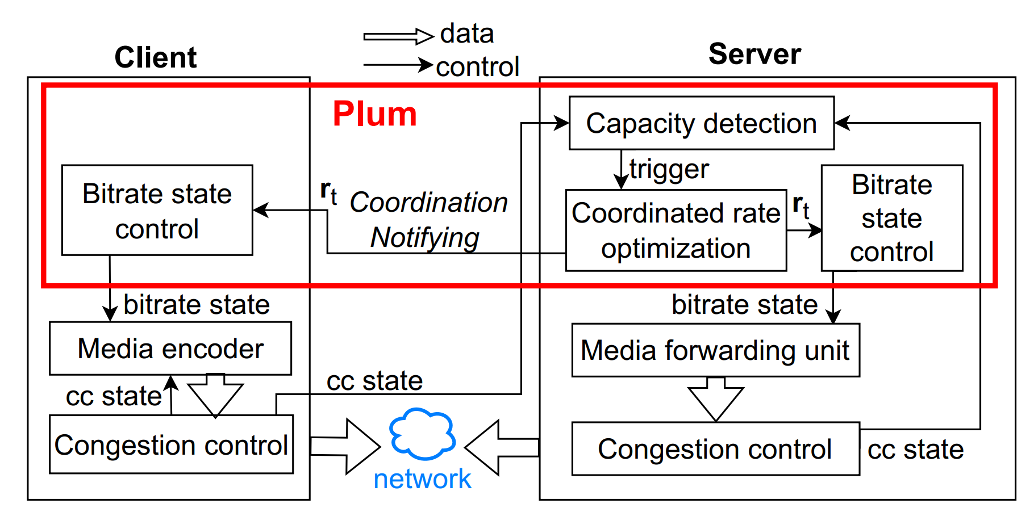
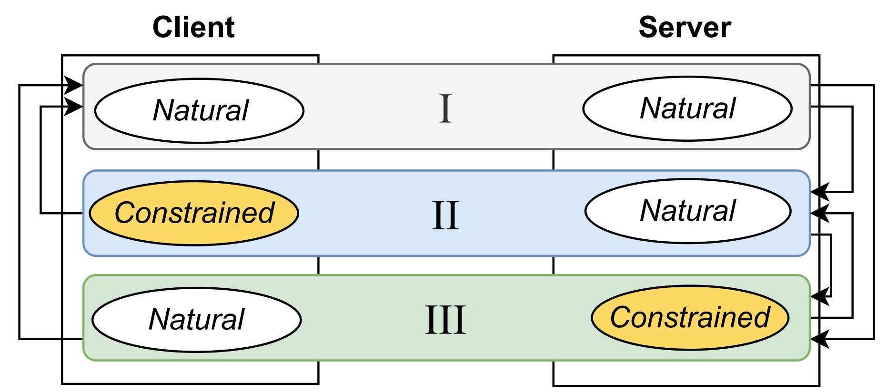
Design -- System
Challenge: How to practically enforce bidirectional bandwidth coordination?
Bidirectional flows have distributed senders. Consistency?
How to work well with existing rate control mechanisms e.g. congestion control
Entangled state machines to ensure consistency
No interruption to congestion control
Operating at different time granularity
Notes:
From the system level there are also challenges. Since the bidirectional flows have distributed senders (i.e., clients and a relay server), it needs careful system designs to all the senders cooperatively control their rates without inconsistency. It is also important to work well with existing rate control mechanisms like congestion control. In response, we design a server-dominant system that uses (Click) entangled state machines to consistently control flow bitrates. The state transitions are made at the server and notified to all the users. (Click) Also, as we do not interrupt the congestion control logic, the transport layer would see data coming from the application with varying rates, but the variation would be much less frequent compared with congestion control. For more design details, please refer to our paper

Slide 14
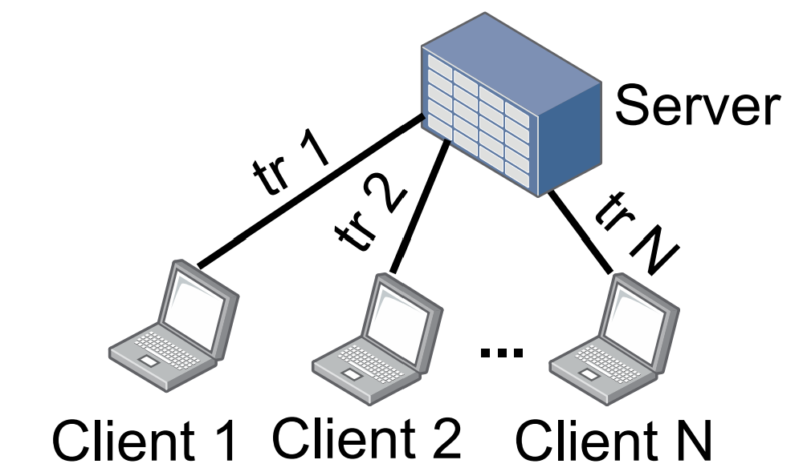
Evaluation
NS-3 simulation
With real-world WiFi traces
Plum
48%
The best of the baselines
Notes:
Now for the evaluation part. We first use NS-3 simulations with real-world wifi traces to evaluate the performance gains achieved by Plum. (Click) In the experimental topology, all clients are connected to a central server following the SFU WebRTC architecture, and the access network of each client is independent. (Click) With different number of clients pushing flows to the server and downloading the data of other clients from the server, the average downlink bitrate of the best of the baselines are like this. (Click) As Plum could coordinate the bidirectional rates, we improve the average bitrate by up to 48%. As the number of clients increases, the improvement increases, since more clients would amplify the benefit of unfair bidirectional bandwidths. The highest downlink bitrate is reached at 8 clients. We also build up a small testbed with a Wifi router and a laptop and several servers to replicate this results.

Slide 15
Evaluation
Improving average playback bitrate by 48~59% compared to the best of the baselines (NS-3 simulation)
Improving average playback bitrate by 16% in testbed experiments
Optimization latency 20 ms (with 5 users interacting)
High fairness among the users
Many other variant scenarios in paper …
Notes:
For more highlights in our evaluation, xxx. The algorithm of Plum is also lightweight, we only need around 20ms optimization latency with 5 users interacting in the application. While improving the average performance Plum also maintain high fairness among the users. There are still many other experiments containing other variant scenarios, please refer to our paper.

Slide 16
Takeaways
We identify the lack of bandwidth coordination between uplink and downlink traffic under WiFi bottlenecks, which impairs the performance of streaming applications.
We design Plum, a bandwidth coordination method, that tailors the uplink and downlink bitrate to acquire more reasonable bandwidth shares.
We evaluate Plum with both NS-3 simulations and testbed experiments to prove its performance, user fairness, and effectiveness.
Plum is open sourced and available on GitHub: https://github.com/PlumRateControl/Plum

Slide 17
Thank you for your listening! Welcome any questions & comments
Jing Chen
E-mail: j-c23@mails.tsinghua.edu.cn
Website: https://chenjing98.github.io

