Slide 1
PiTree: Practical Implementations of ABR Algorithms Using Decision Trees
https://transys.io/pitree
Zili Meng Jing Chen Yaning Guo Chen Sun Hongxin Hu Mingwei Xu
Notes:
Thanks for the introduction. I’m Zili from Tsinghua University
I’m going to present our work to enable practical implementations of adaptive bitrate algorithms with PiTree.
This is a joint work with Jing, Yaning, Chen, Mingwei from Tsinghua, and Hongxin from Clemson.

Slide 2
Adaptive Bitrate (ABR) Algorithms
Video server
Client
Quality
Bandwidth
Quality
High
ABR
Medium
Low
Time
Time
Time
Partially borrowed from “Neural Adaptive Content-aware Internet Video Delivery” in USENIX NSDI 2018.
Notes:
Adaptive streaming has been widely deployed in video delivery and has become a primary tool for improving user quality of experience. In adaptive streaming, a video is encoded into multiple quality levels and divided into fixed sized chunks. (click)
Then, the client runs an adaptive bitrate algorithm, or ABR, to choose an appropriate quality for the given network bandwidth.

Slide 3
Adaptive Bitrate (ABR) Algorithms
Deep Learning
Neural Networks
Complexity
Deeper NNs
Complex Optimization
Linear Programming
Hidden Markov Model
Explicit Formula
Harmonic Mean (Rate)
Piecewise Linear (Buffer)
2011 | 2012 | 2013 | 2014 | 2015 | 2016 | 2017 | 2018 | 2019
Notes:
Let’s briefly review the history of ABR algorithms in recent years. (click)
At the early stage, ABR algorithms usually make decisions for the next bitrate with very simple methods, such as a piecewise linear function. (click)
Gradually, more complex methods are introduced to improve the user experience. (click)
The latest research efforts employ deep learning techniques and outperform heuristic methods developed in recent years. (click)
However, as we can see, with the improvement of the performance of those algorithms, their complexity also goes up.

Slide 4
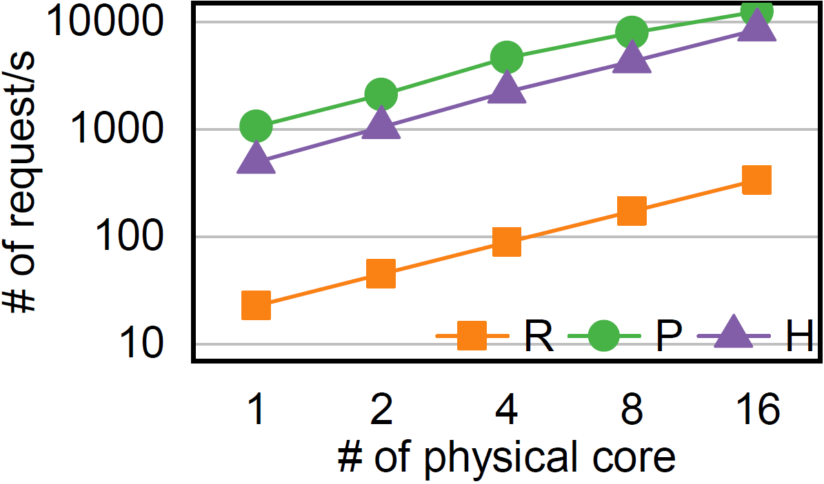
Drawbacks – Heavyweight
Client-side Implementation
Server-side Implementation
Large page size.
Pensieve ^{[SIGCOMM’17]} increased HTML page size by 4x.
Page load time is increased by $\sim$10s.
Long decision latency.
RobustMPC ^{[SIGCOMM’15]} increased decision latency to seconds.
Decision latency > chunk length.
High operating expenses.
Up to millions of concurrent viewers.
R = RobustMPC [SIGCOMM’15]: ILP
P = Pensieve [SIGCOMM’17]: DNN
H = HotDASH [ICNP’18]: 2xDNN
Notes:
So let’s take a look on the two current ways to implement the ABR algorithms. If you decide to implement the ABR on video clients, the video player needs to load the decision model before the start of the video. However, the decision models of neural network-based ABR algorithms are usually several megabytes, which might introduce additional ten seconds to load the model. (click)
As for those linear-programming based methods, if the player solve the linear programming at each video chunk, the computation time sometimes cannot catch up with the chunk length, which will stall the video and degrade the user experience. (click)
On the other hand, if you choose to implement the ABR on servers, due to the complexity of computation and also the big number of concurrent viewers, content providers need to deploy considerable servers to process the ABR requests, which is quite expensive.

Slide 5
Our Contribution: PiTree
Design & train ABR algorithms offline as usual.
Convert the model into a decision tree.
Deploy the decision tree online.
Decision tree
Offline training/design
Online deployment
Sophisticated ABR model
(e.g., DNN, ILP)
network traces
decisions
Notes:
Based on this, we propose PiTree. Our solution is quite simple. Researchers can still design and train their ABR algorithms as usual with any mathematical tools and development platform. (click)
Then PiTree uses the traces and the decisions generated by the original model to train a decision tree (click)
and deploys the decision tree online into video players.

Slide 6
Design Choice: Why Decision Tree?
Non-parametric and expressive.
internal nodes
low local approximation error
$$S_{2}$$
leaf nodes
decision boundary
state space
$$S_{1}$$
Notes:
So here comes a question. Why does PiTree choose decision tree as the target model of the conversion? The first reason is that the rich expressiveness of decision trees enables the high faithfulness of conversion. They are non-parametric and could represent very complex policies.

Slide 7
Design Choice: Why Decision Tree?
Non-parametric and expressive.
Lightweight for video players.
A decision tree with 100 leaf nodes:
Page size increase <1%
Decision latency <1ms
laptop
smartphone
Notes:
The second reason is that binary decision trees are only comprised of conditional judgments that could be easily implemented into JavaScript with branching clauses. Our evaluation further demonstrates the lightweightness of decision trees.

Slide 8
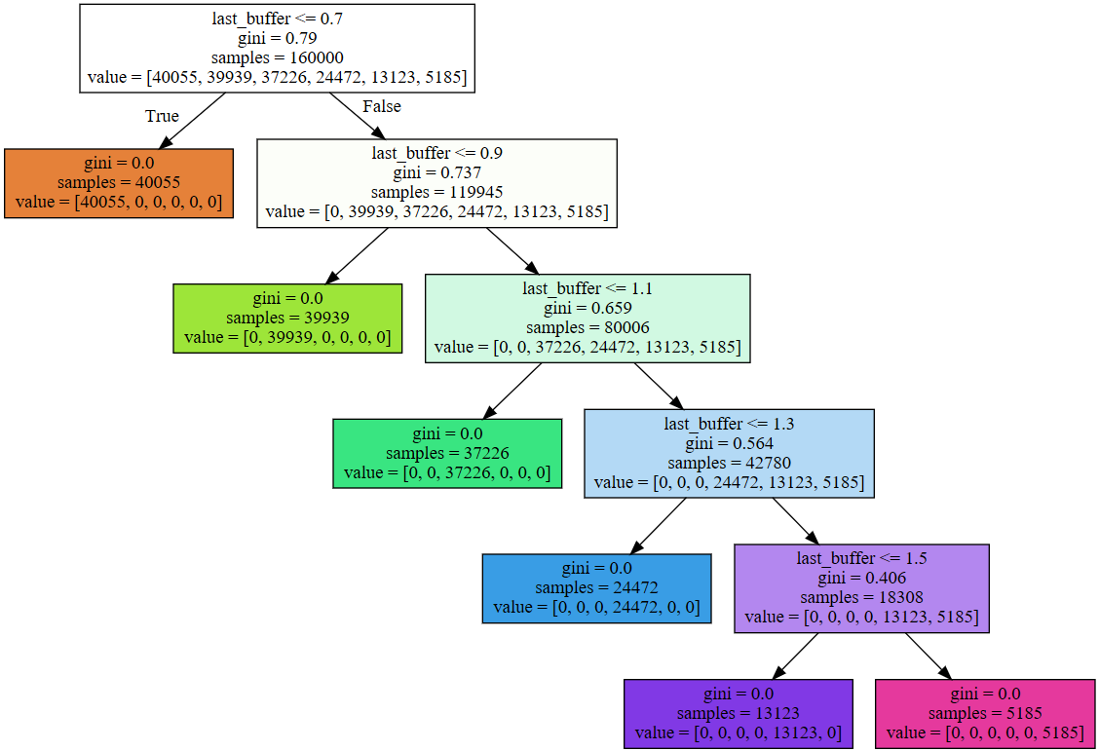
Design Choice: Why Decision Tree?
Non-parametric and expressive.
Lightweight for video players.
Following the decision logic of ABR algorithms.
Decision tree of BBA ^{[SIGCOMM’14]}.
Notes:
The third reason is that optimizing the user experience is usually a multi-objective optimization. When the ABR algorithms select a bitrate for the next chunk, they need to consider many factors such as the rebuffer, smoothness, and so on. The combination of judgments resembles the structure of decision trees.

Slide 9
Design Challenge: Sequential Dependency
ABR Control is a sequential decision-making process.
bandwidth logs
ABR Controller
chunk
Internet
HTTP
bitrate
request
Buffer
buffer occupancy
Notes:
However, converting the ABR models into decision trees confronts a domain-specific challenge: ABR control is a sequential decision-making process, where the action at the current step will affect the state at the next step. (click)
At first, the Internet sends a chunk to the video player with the initial bitrate. The video player puts the chunk into its buffer, and tells the ABR controller its current states such as buffer occupancy and bandwidth. The ABR controller makes a decision on the bitrate of the next chunk, and the video player sends the chunk to the server. (click)
However, the download time of the next chunk depends on the bitrate, and will further affects the throughput and buffer states at the next time of decision.

Slide 10
Design Challenge: Sequential Dependency
ABR Control is a sequential decision-making process.
One wrong prediction may drive the student off teacher’s trajectory.
unexperienced state space
prediction error
teacher
student
Notes:
So suppose now we have a series of state-action pairs of the original ABR algorithm, or the teacher. They might be like these triangle points in the state space. If we just use these points to train the decision tree, or the student, how will it behave when making decisions itself? (click)
At first, the decision tree may faithfully mimic the behaviors of the teacher’s. (click)
But once the student makes one wrong prediction, it will be dragged into a part of state space that the student has not experienced during training. (click)
The decision tree might therefore make random decisions and drive itself far from the teacher’s trajectory.

Slide 11
PiTree: Imitation Learning – Follow the Leader
(in)correct actions
states
traffic traces
teacher.predict()
virtual player
videos
add into
train
add into
retrain
correct actions
(s,a) set
decision tree
deploy onto video clients
Notes:
In response, PiTree adopts an imitation learning algorithm named follow the leader. (click)
In the beginning, we still use the set of state-action pairs to generate a decision tree. (click)
Next, we introduce a virtual player based on the traffic traces and video information collected from historical data. We run the decision tree individually in the virtual player and collect the states and actions generated by the decision tree. Note that the actions here might be incorrect from those of the original teacher. (click)
Then, we call up the predict function of the teacher. This could be the inference stage of the neural network, or the optimization of the linear programming. We then could know how the teachers behave under the same states with the student. (click)
After that, we add the newly generated state-action pairs to the dataset, retrain the decision tree, and continue the loop. The final decision tree could be deployed onto video clients with high performance.

Slide 12
For design details and theoretical analysis, please refer to our paper.

Slide 13
Evaluation – Quality of Experience (QoE) Ratio
Summary of experiments
3 QoE metrics.
3 sets of bandwidth traces.
3 ABR algorithms.
$QoE ratio=\frac{QoE_{PiTree}}{QoE_{Original}}$
Average QoE ratio > 97%.
Median QoE ratio > 98%.
Details in the paper.
Pensieve
HotDASH
RobustMPC
98%
Notes:
We measure the ratio of QoE of PiTree over its original algorithm. From the evaluation results, both the average and median QoE ratio is quite near to 100%, indicating PiTree could faithfully convert those complicated algorithms into decision trees.

Slide 14
Evaluation – Page Size
14.5s @ 1Mbps
Our experiments:
<0.1s @ 1Mbps
RobustMPC [SIGCOMM’15]: ILP
Pensieve [SIGCOMM’17]: DNN
HotDASH [ICNP’18]: 2xDNN
Notes:
We further measure the HTML page size of different algorithms. If we directly implement Pensieve and HotDASH, two recent ABR algorithms, into HTML pages, the page size will be increased by up to 6 times. This will introduce an additional page load time of more than ten seconds when the bandwidth is one Mbps. (click)
The page size of the decision tree is satisfying. For three decision trees we use in the experiments in last page, the additional page load time is less than 100 milliseconds.

Slide 15
Evaluation – Latency
10s
1s
0.1s
10ms
1ms
0.1ms
10μs
$\sim$4s
Intel Core i7-8550
1ms
RobustMPC [SIGCOMM’15]: ILP
Pensieve [SIGCOMM’17]: DNN
HotDASH [ICNP’18]: 2xDNN
Qualcomm Snapdragon 821
Notes:
Experiments on the decision latency also show promising results. If we directly implement the RobustMPC in the video player, the decision latency on my laptop would be near four seconds. Experiments on mobile phones are even worse. This indicates that sometimes the decision latency is longer than the chunk length, which will stall the video. (click)
In contrast, the decision latency of PiTree is less than one millisecond. This is much less than the length of a chunk.

Slide 16
Takeaways
Current ABR algorithms are increasingly heavyweight.
PiTree convert complex ABR algorithms to decision trees to deploy them in a lightweight way.
Use imitation learning to address the action dependency.
PiTree can significantly reduce the algorithm overhead with negligible QoE loss.
Page size reduced by up to 5x, decision latency reduced by up to 1000x.
Notes:
In summary, the key takeways from our experiences are shown on the screen. We find that current ABR algorithms are too heavyweight to be deployed onto clients. Thus, we convert those heavyweight models into decision trees and achieve promising overhead benefits with almost no performance loss.

Slide 17
Thank you! Questions and comments?
Try your ABR algorithms with PiTree!
https://transys.io/pitree
zilim@ieee.org
Notes:
PiTree is now available at our website. Thank you for your listening. I’d like to take any questions.

Slide 18
Backup Slides

Slide 19
Evaluation – Deployment Efforts
Operating expenses.
Zero (no need to deploy on servers).
Decision tree conversion cost.
$\sim$2 hours only.
Sensitivity analysis.
Performance is hardly affected when leaf nodes is more than $\sim$100.
Generalization ability.
Generalize well on unmet traces.

